Slide 1
MRT Information System
MA1008 Mini Project
Semester 2, AY 2024/2025

Slide 2
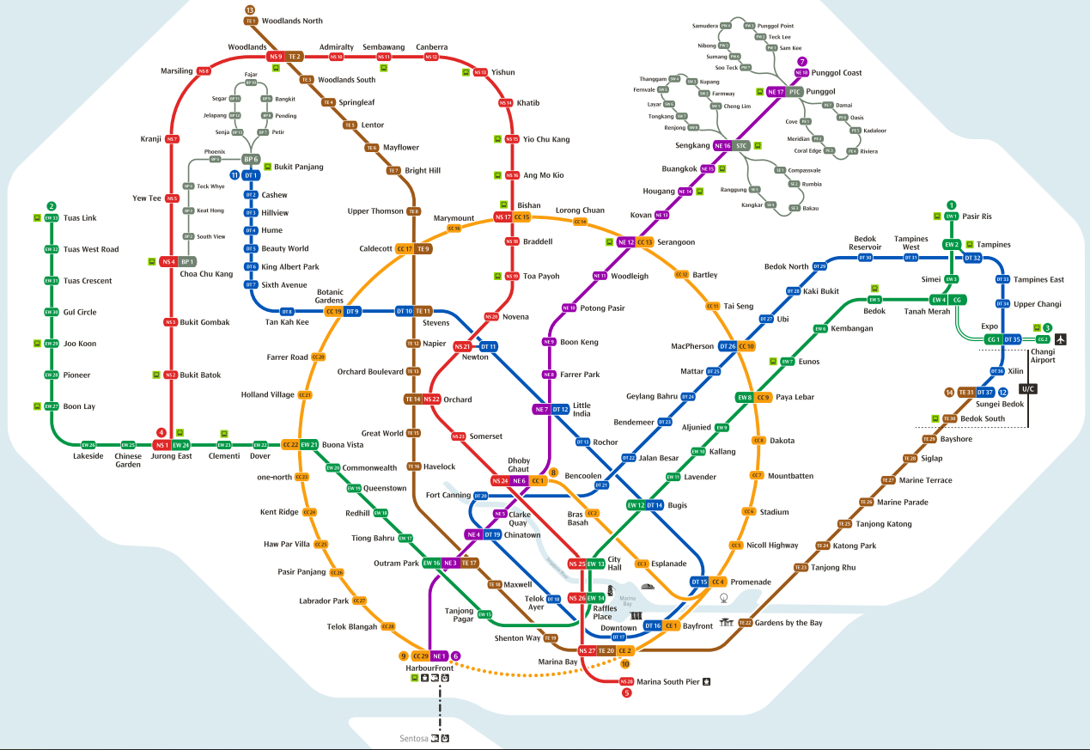

Slide 3
MRT Lines – Colour Coded
Circle
Downtown
East-West
North East
North-South
Thomson-East Coast

Slide 4
MRT Data – MRT.txt
No.;Station Pair;Line;Distance;First;Last;First opp;Last opp
1;CC1 Dhoby Ghaut <-> CC2 Bras Basah;Circle;0.6;0607;2357;0554;0003
2;CC2 Bras Basah <-> CC3 Esplanade;Circle;0.7;0539;2250;0552;0001
3;CC3 Esplanade <-> CC4 Promenade;Circle;0.8;0541;2251;0550;2359
28;CC28 Telok Blangah <-> CC29 Harbour Front;Circle;1.5;0544;2346;0530;2303
29;CE2 Marina Bay <-> CE1 Bayfront;Circle;0.8;0559;2355;0617;2351
30;DT1 Bukit Panjang <-> DT2 Cashew;Downtown;1.2;0530;2335;0614;0046
31;DT2 Cashew <-> DT3 Hillview;Downtown;0.9;0532;2337;0613;0045
32;DT3 Hillview <-> DT4 Hume;Downtown;0.7;0534;2338;0611;0043
62;DT33 Tampines East <-> DT34 Upper Changi;Downtown;2.6;0618;0038;0538;2341
63;DT34 Upper Changi <-> DT35 Expo;Downtown;0.9;0621;0041;0536;2340
64;EW1 Pasir Ris <-> EW2 Tampines;East–West;2.4;0528;2323;0521;0037
65;EW2 Tampines <-> EW3 Simei;East–West;1.4;0531;2326;0519;0034
66;EW3 Simei <-> EW4CG Tanah Merah;East–West;2.5;0533;2328;0516;0031
137;NS25 City Hall <-> NS26 Raffles Place;North–South;1.0;0554;2352;0603;2353
138;NS26 Raffles Place <-> NS27 Marina Bay;North–South;1.0;0557;2354;0601;2350
139;NS27 Marina Bay <-> NS28 Marina South Pier;North–South;1.4;0601;2350;0605;2356
140;TE1 Woodlands North <-> TE2 Woodlands;Thomson–East Coast;1.4;0536;2330;0539;0042
141;TE2 Woodlands <-> TE3 Woodlands South;Thomson–East Coast;1.4;0538;2333;0536;0040
142;TE3 Woodlands South <-> TE4 Springleaf;Thomson–East Coast;4.4;0540;2335;0604;0035

Slide 5
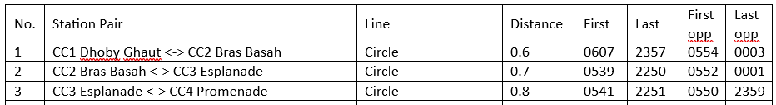
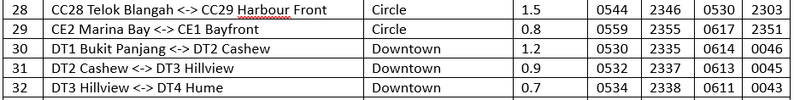
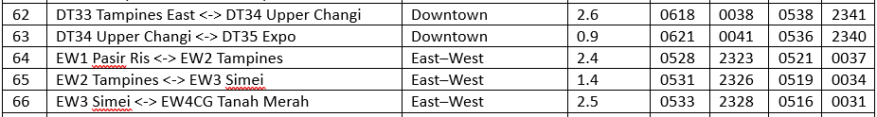
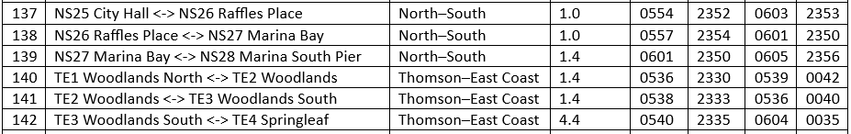
MRT Data - Tabulated

Slide 6
A line of data
No.;Station Pair;Line;Distance;First;Last;First opp;Last opp
1;CC1 Dhoby Ghaut <-> CC2 Bras Basah;Circle;0.6;0607;2357;0554;0003
A semi-colon separates two data items
Station identified by code and name: CC1 Dhoby Ghaut
Item 2 contains two adjacent stations
Distance is in km
Time written in four digits: hhmm
hh = hour in 24 hour format, mm = minutes
Single digit number written with a preceding 0

Slide 7
MRT Train Speeds
Circle 36 km/hr
Downtown 38 km/hr
East-West 43 km/hr
North East 34 km/hr
North-South 41 km/hr
Thomson-East Coast 40 km/hr

Slide 8
Program objectives
Extract useful information from the given data and display it.
Information extracted based on queries.
The display is to be in graphical form, nicely laid out.
Most outputs are text, but can be enhanced with graphical illustration.

Slide 9

Example query and output
How to get from Yio Chu Kang to Pioneer?
MRT Information System
Pioneer
Boon Lay
NS16 Yio Chu Kang To EW28 Pioneer
Change to East-West Line at NS1 Jurong East
Lakeside
Chinese Garden
Bukit Gombak
Yew Tee
Marsiling
Admiralty
Canberra
Khatib
Jurong East
Bukit Batok
Choa Chu Kang
Kranji
Woodlands
Sembawang
Yishun
Yio Chu Kang

Slide 10
Another Example Query and Output
How to get from Kent Ridge to Choa Chu Kang?
Choa Chu Kang
Bukit Batok
Jurong East
MRT Information System
Bukit Gombak
Clementi
CC24 Kent Ridge To NS4 Choa Chu Kang
Change to East-West Line at CC22 Buona Vista
Change to North South Line at EW24 Jurong East
Dover
One North
Buona Vista
Kent Ridge

Slide 11
The queries
Four prescribed queries:
Given an MRT line, list all its stations in order.
Find and display the best route between two stations.
Display the distance and time of travel between two stations.
What is the latest time one must catch a train at Station A in order to arrive at Station B before or on its last train?
Four queries of your choice

Slide 12
Other Data
You may provide additional data of your own beyond what has been given.
Your queries may use the additional data to provide further information.
Examples:
Peak hour periods
Train fare, https://www.ptc.gov.sg/fare-regulation/bus-rail/fare-structure
LRT connections
Bonus marks will be given to additional data well handled.

Slide 13
User Inputs
Types of input:
Station or MRT line name
Time
Make the input as simple and as little as possible
Never ask for a long input if it can be done in short
Better to select from a menu instead of typing in commands
Always make sure that the user knows what the program requires at all times

Slide 14
About turtle
A Python library for graphics
Points, lines
Text
Shapes / circles / dots
Colours
Demo of turtle

Slide 15
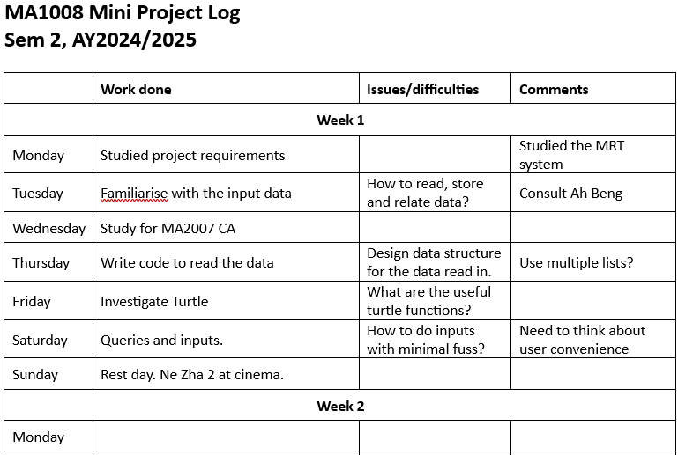
Project log – weekly submission
Keep a project log which records your progress
Submit it at the end of each week
Plus the program at the time

Slide 16
About creating a large-ish program
Know your requirements
Design the solution from the top down
Break your problem down into modules
Each module may have sub-modules
Often, each module is a function
But do your coding from the bottom up, module by module
Lowest level functions first
Design your functions, such that they are reusable
High level functions are for modularization, not reuse

Slide 17
Prohibitions
Do not use the class construct
Do not use tkinter, matplotlib, plotly or similar for graphics, only turtle.
Do not use the libraries numpy, pygame or json.
Do not use the lambda construct
Do not use the eval() function.

Slide 18
You need to be able to explain everything in your program.

Slide 19
Grading Rubrics
The code quality of your program
Data structure
Modularisation, including good use of functions.
Clarity and ease of reading
The features that you program offers
User input
Ease of inputting the required information
Quality of your outputs
15% for interim marks
20% bonus marks, which is outside the 100% of the project. Potentially, you can score 120%.

Slide 20
What you have to submit at the end
Your program
A report
User guide to your program
Sample outputs for each of the queries together with the graphical displays
Highlights of strengths and weaknesses
Highlight bonus features
Submission deadline: 23:59, 20 April.

